Slide 1
Microservices Orchestration and Workflows
AWS Step Functions vs OIC - HL Comparison
Contributors
Peter Obert – AI and App Integration, API Mgmt. and Process Automation Black Belt
EMEA TE
Apr 2026
Notes:
I would like to thank all the contributors to this workshop: Valeria, Bogdan, Brian, Aishwarya, Milomir and a very special thanks to PM Niall Commiskey for his valuable insights and support.

Slide 3
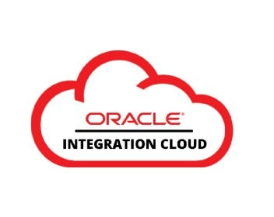
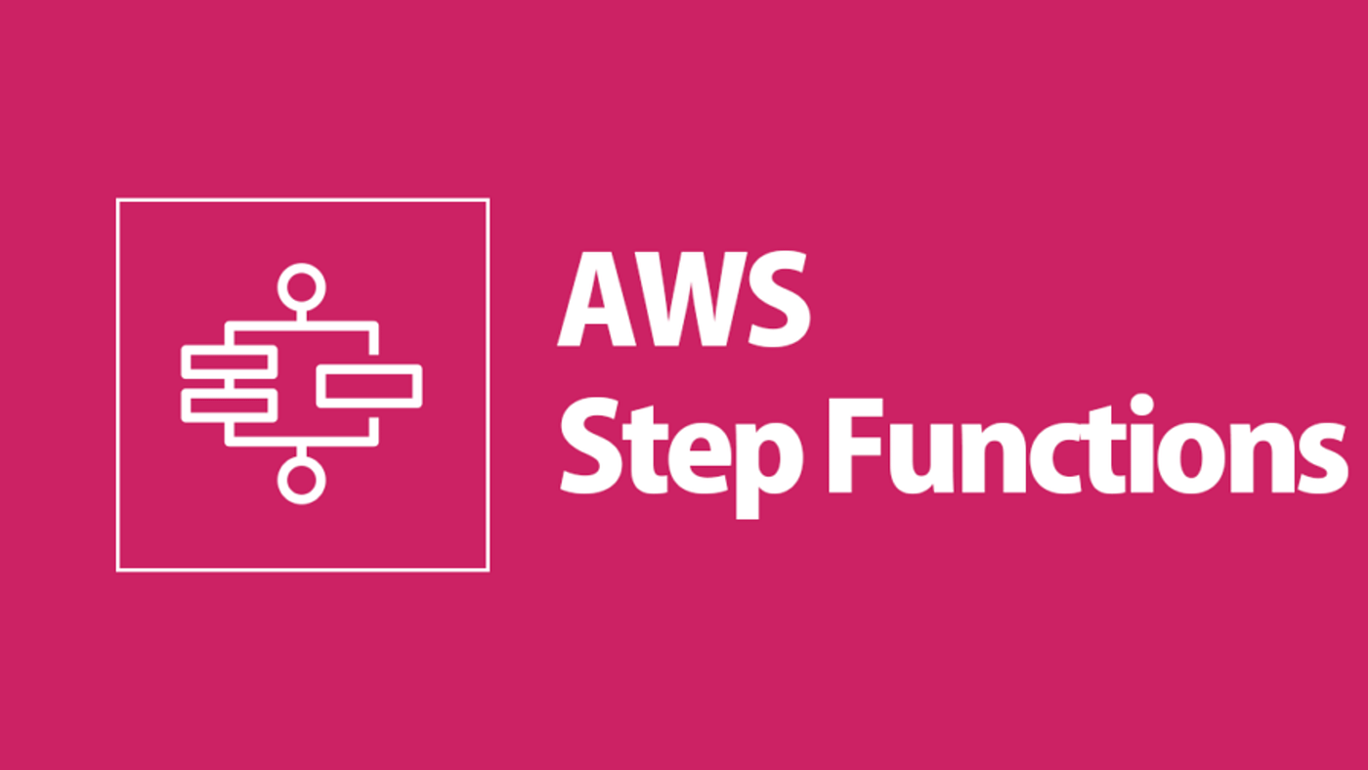
Overview
Both tools orchestrate workflows — but serve very different purposes
AWS Step Functions
Oracle Integration Cloud (OIC)
A serverless orchestration service designed to manage workflows between AWS services using JSON-based state machines.
Key characteristics:
Native to AWS ecosystem
Code-heavy (ASL/JSON)
Highly scalable
Ideal for microservices architectures
Per state transition pricing
A comprehensive Oracle Managed Serverless iPaaS connecting Oracle SaaS applications with on-premises or cloud systems.
Key characteristics:
Visual low-code / no-code interface
Rich pre-built connectors
Broader platform than Step Functions
Supports B2B, hybrid cloud, AI orchestration
Per message/activity pricing

Slide 4
AWS Step Functions
Serverless Orchestration
State Machine (ASL/JSON)
AWS Native
Manages workflows between AWS services (Lambda, DynamoDB, SNS/SQS) without provisioning servers.
Workflows defined in Amazon States Language — a JSON-based declarative syntax for complex conditional logic.
Deep integration with the full AWS service catalog including S3, ECS, Glue, Bedrock and more.
Standard & Express Workflows
High Scalability
Developer-Focused
Standard: long-running, auditable. Express: high-volume, short-duration event processing.
Auto-scales to handle thousands of concurrent executions; suited for high-volume microservices.
Moderate learning curve requiring knowledge of ASL/JSON. Code-heavy, best for engineering teams.

Slide 5
Oracle Integration Cloud (OIC)
iPaaS Platform
Visual Low-Code Interface
Pre-built Connectors
Comprehensive Integration Platform as a Service — a much broader toolset than a simple orchestration service.
Drag-and-drop workflow designer makes integration accessible to developers and non-developers alike.
Rich library of technology and application adapters: Oracle ERP, SAP, Salesforce, social platforms and more.
B2B & Hybrid Cloud
AI & Agentic Orchestration
Oracle Ecosystem First
Supports EDI-based B2B integrations, on-premises connectivity, and complex hybrid cloud architectures.
Enables AI services orchestration and exposes Integrations as AI Tools (MCP Servers) for agentic AI use cases.
Best-in-class for Oracle SaaS apps (ERP Cloud, HCM, CX) and extending Oracle application workflows.

Slide 6
Key Differences
Feature | AWS Step Functions | Oracle OIC
Primary Focus | Serverless microservices orchestration within AWS | Enterprise Application Integration & business services orchestration
Development Style | Code-heavy (ASL / JSON) | Visual Low-Code / No-Code
Integrations | Best for AWS services (Lambda, SQS, S3) | Rich pre-built adapters: Oracle ERP, SAP, Salesforce, social & more
Best For | Complex logic, high-volume serverless workloads | App extensions, B2B, hybrid cloud, AI orchestration, MCP Servers
Pricing Model | Per state transition (Standard / Express) | Per Message / Activity
Learning Curve | Moderate — requires ASL knowledge | Low to Moderate — drag-and-drop designer

Slide 7
When to Choose Each?
Match the tool to your architecture and integration needs
Choose AWS Step Functions when…
Choose Oracle OIC when…
You are fully invested in the AWS ecosystem
Your workflows are tightly coupled to Lambda / AWS services
You need high-throughput, low-latency event processing
Your team is comfortable with ASL / JSON coding
You are building complex microservices with branching logic
You use Oracle SaaS apps (ERP, HCM, CX Cloud)
You need to connect to business services or applications like SAP, Salesforce, or legacy on-premises systems
Your team prefers a visual, low-code approach
You require B2B/EDI integrations or hybrid cloud connectivity
You want AI/agentic orchestration and MCP Server exposure

Slide 8
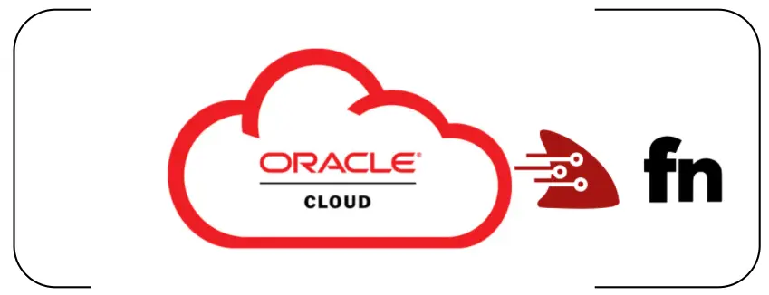
Replace AWS Step Functions with OCI Services
Why/When to Replace AWS Step Functions?
Amazon’s Step Functions enable coordination of distributed applications using functions or microservices as steps in a workflow. However, this approach can result in tightly coupled orchestration logic that’s difficult to port across clouds and is dependent on AWS Lambda, which is itself a proprietary and cloud-specific compute service.
The challenges:
Vendor Lock-In: AWS Step Functions and Lambda are only available on AWS.
Limited Portability: Function code can’t be easily moved to other cloud environments.
Complexity: As workflows grow, Step Function definitions can become difficult to maintain and evolve.
See:
Modernizing Cloud Workflows: Replacing AWS Step Functions with OCI Functions and Oracle Integration Cloud
Oracle Integration 3 - Using OIC Native Actions to Harness OCI Services(OIC + OCI Functions) livelab

Slide 9
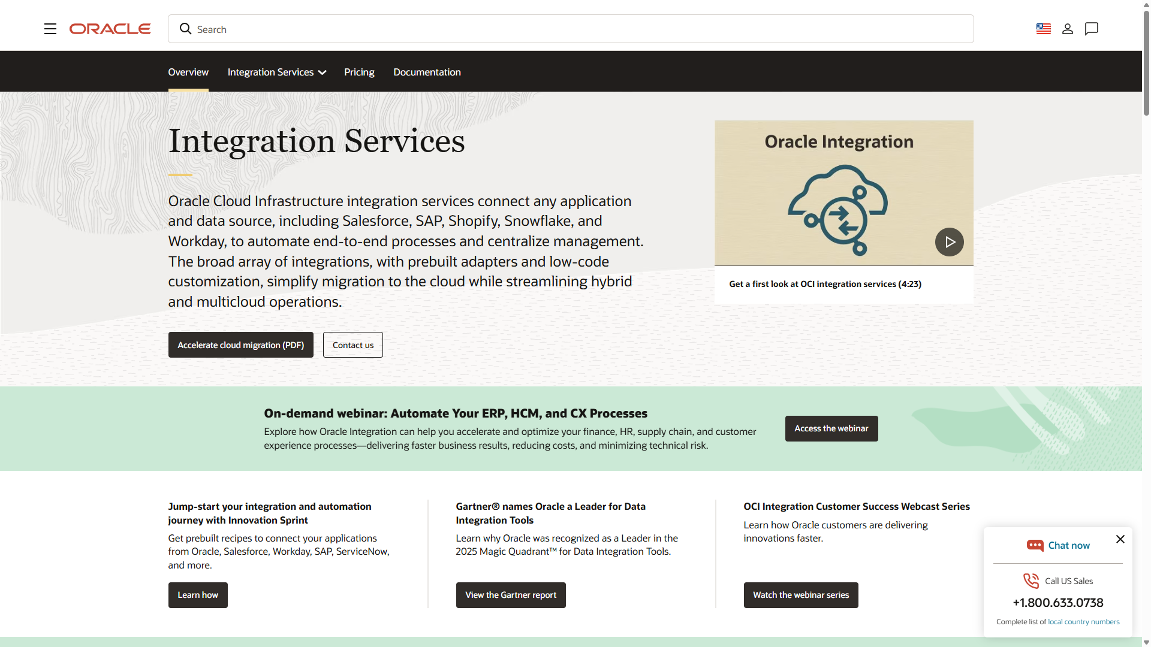
Learn more
Visit https://www.oracle.com/integration/

Slide 10
Thank you

